Slide 1
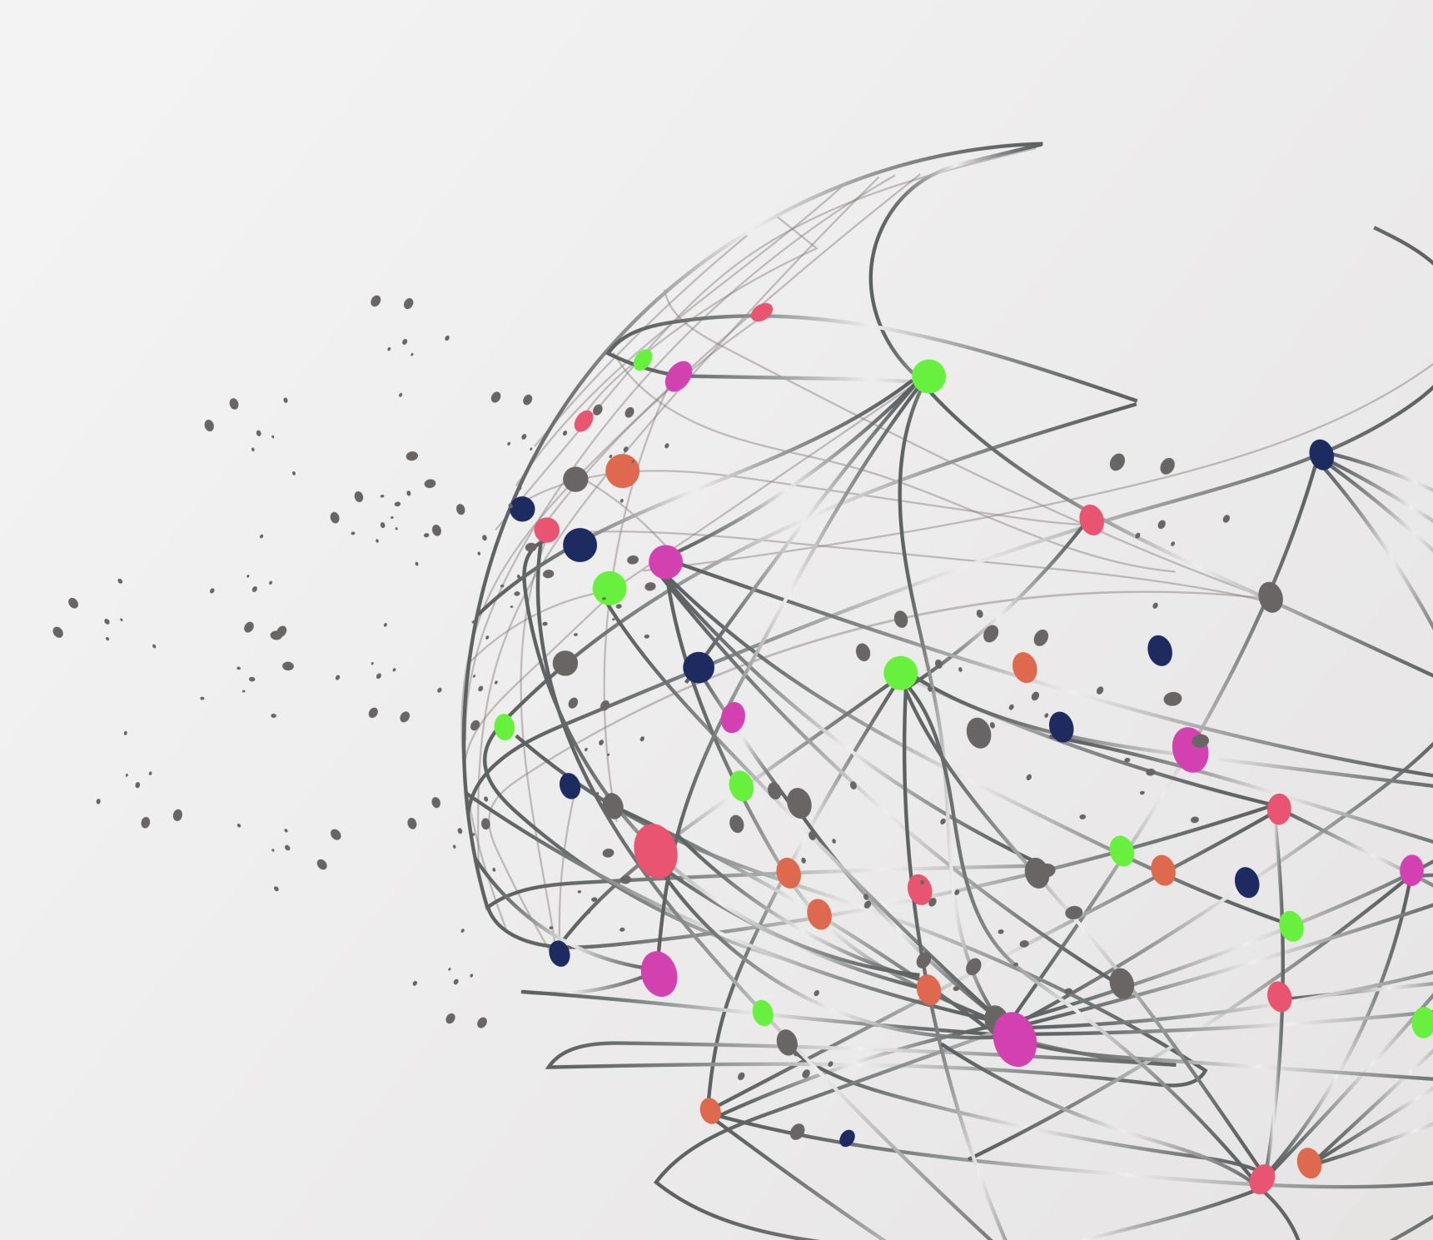
Agile Presentation
By
Dylan Cavazos

Slide 2

Scrum-Agile Team
Product Owner: The Product Owner essentially acts an interpreter for the customers and stakeholders. They help in defining the requirements set forth by the customers and translating those requirements to the developers. They are also responsible for managing the product backlog, which is used by the developers to pull tasks from. While the Product Owner is the intermediary between the team and the clients they also must “not only understand the customer but also have a vision or the value the scrum team is delivering to the customer.” (West, n.d.)
Scrum Master: The scrum master is the person who keeps everything together and ensures that the scrum framework is in place. They can also be described as a “servant leader” because they help in communicating the necessary value between the development team and the product owner. They also serve the product owner in several ways by helping coordinate the sprint planning and sprint reviews. (West, n.d.)
Developers: The development team is comprised of a diverse set of individuals each with contributing values. The team is often composed of various “designers, writers, programmers, etc.” (West, n.d.). While they serve multiple purposes, they primarily are responsible for building the foundation of the design. The developers also contribute to the collaboration of the scrum-agile team by initiating what’s called a “Daily Scrum” which acts as a dedicated time and space for team members to collaborate on ideas and issues and help each other through various problems.

Slide 3

Agile Software Development Lifecycle
The Agile Software Development Lifecycle comprises multiple phases, emphasizing an iterative approach to enable continuous development while accommodating evolving requirements.
Requirements gathering and analysis: This phase of the SDLC is often facilitated by the product owner and is the phase where the information requirements are gathered about a particular product. These requirements are typically addressed by various stakeholders or customers.
Design: The design phase is especially critical because it lays the foundation down for the overall structure of the product. The design also helps to identify the various use-cases and relationships between the systems users. It can be broken down into multiple steps including a high-level design and low-level design, whether the former encompasses the various software products involved and the latter illustrates how the components of a system work together. (GeeksforGeeks, 2023a)
Implementation or coding: The implementation or coding phase is the part of the lifecycle where the actual development is put into practice. The development utilizes the structure outlined in the design phase and physically demonstrates the relationships between various Classes and Objects of the design. This development phase is also the longest phase in the SDLC as it’s broken down in multiple levels which tie together each aspect of the entire system. Including the back-end, the middleware, and the front-end, which is the part of the system that the users interact with. Capturing these aspects correctly is important to meeting the requirements set forth during the first phase of the SDLC. (GeeksforGeeks, 2023a)
Testing: The testing phase is crucial in making sure that the system is working correctly, following the implementation phase. This phase is where the developers, specifically the testers ensure that the system is accurately meeting the necessary requirements and is thoroughly tested for user interaction.
Deployment: After the testing for the system is proven to work correctly, the deployment phase is where the system is finally deployed to production where it can be accessed to the various end-users. (GeeksforGeeks, 2023a)
Maintenance: Finally, the maintenance phase helps to keep up with the support for the system, including addressing the various bugs, updates, or necessary fixes to the system. (GeeksforGeeks, 2023a)

Slide 4

Agile vs. Waterfall
For SNHU Travel, utilizing an agile development approach was crucial because it allowed certain adaptations when dealing with continuous refinement of requirements for the system. However, in a Waterfall approach, the process would be drastically different. Some of the reasons why include:
Waterfall inherently has a lack of flexibility. One reason for this is that Waterfall identifies the requirements in advance, and once those requirements are properly outlined, they are often help in place until final deployment of the product. This can lead to constraints in flexibility during different phases of the life cycle, since the process is much more rigid. (Agile Vs. Waterfall, 2021b)
There are fewer opportunities to revisit older processes for refinement. An example of this would be when the requirements changed during the development process to shift towards a new requirement for the vacation packages. While in Agile approach, this may require shift in the product backlog and the discontinuation of user stories, in a Waterfall approach, the deadline may not have allowed enough time to shift the focus back to development to meet a new requirement such as this. (Agile Vs. Waterfall, 2021b)
Utilizing a Waterfall approach versus an Agile approach for SNHU Travel may have resulted in the process being much stricter. The Waterfall approach doesn’t compensate for unexpected changes in requirements while in the middle of design and development.

Slide 5

Factors for Waterfall or Agile approach
When trying to determine whether a Waterfall approach is best or an Agile approach some of the factors I would consider, include:
Project Size: Depending on the size of the project, one approach may be better than the other in terms of how to handle the scope of requirements. As well what to anticipate for scope, time, and size of the process. Larger projects may tend to use a Waterfall approach over an Agile approach since larger projects may have requirements that are less geared towards a specific audience. Smaller projects benefit more from Agile since they continuously improve to capture target audiences.
Requirements: The type of requirements set forth by the stakeholders or clients. This can determine what to expect during development and if the process is likely to feature iterative steps for continuous development. If the requirements seem unlikely to change and the product strategy is completely sound, then the system may benefit from a Waterfall approach rather than an Agile approach.
Project deadline: While the deadline during an Agile approach may constantly shift since the processes are not linear, a deadline that is deterministic may benefit from using a Waterfall approach for development instead. The deadline is crucial to the stakeholders so choosing the right strategy is important in meeting clients demands and satisfaction.
Flexibility: Flexibility was key during the SNHU Travel project, where the Agile approach proved invaluable for adapting to changing requirements. Fortunately, the Agile process allows for flexibility in meeting new changes set forth by the stakeholders. This is a key determination when considering Agile versus Waterfall in process development as well. Requirements are likely to change in certain projects, so this must always be kept in consideration on which approach to use for a particular system.

Slide 6

References
Agile vs. Waterfall. (2021, August 26). Pros, Cons, and Key Differences. https://www.productplan.com/learn/agile-vs-waterfall/
GeeksforGeeks. (2023a). What is SDLC Software Development Life Cycle and its phases. GeeksforGeeks. https://www.geeksforgeeks.org/what-is-sdlc-model-and-its-phases/
West, B. D. (n.d.). Agile Scrum Roles | Atlassian. Atlassian. https://www.atlassian.com/agile/scrum/roles

